Slide 1
Cloud Native Application Design
Copyright 2021 Tencent, Inc. or its affiliates. All rights reserved.

Slide 2
Chapter Objectives
After this chapter, you will be able to:
Understand the key technologies of cloud native application
Master the use of the serverless architecture
Notes:
Training Target: Cloud architects. To participate in this training, you need to learn the Tencent Cloud Architecture TCA course first.

Slide 3
Section 1. Overview of Cloud Native Application
Section 2. Implementation of Serverless Architecture in Tencent Cloud

Slide 4
Section 1. Overview of Cloud Native Application
1.1 Application architecture development
1.2 Cloud native architecture and its key technologies
Notes:
This chapter introduces the differences between traditional and cloud-native applications as well as key technologies for cloud-native architectures: microservices, containers, DevOps, and continuous delivery.

Slide 5
1.1 Application architecture development
Three dimensions of applications:
Difficulty in responding promptly to ever-changing market requirements...
Development model
(waterfall)
How do we best adapt to the cloud and take full advantage of it?
Low code reusability, inability to quickly iterate and respond to changes in market requirements...
Application architecture
(monolithic architecture)
System cloudification (IaaS + PaaS)
Significantly reduced costs, greatly improved efficiency in cluster deployment, load balancing, auto scaling, unlimited storage capacity, highly performant cloud relational and NoSQL databases.
System resources
(servers, databases, etc.)
Notes:
From the application development as well as deployment process, the application is simply divided into three dimensions: system resources (used to develop and deploy the application), development model (the application development process), and application (software product)
Through the use of cloud resources such as cloud server CVM, load balancing, elastic scaling, cloud database MySQL, cloud database MongoDB, COS object storage, etc., we have begun to use the advantages of the cloud to improve the enterprise IT environment, but have not yet fully played the characteristics of the cloud; with the application on the cloud, the cost of the application itself is getting lower and lower, and the load capacity has been greatly prompted, but the application itself With the development of the business, the user scale is rising, the market demand is changing, and the market requirements for application iteration and update are getting faster and faster (the development must quickly keep up with the market demand, otherwise it is likely to miss the opportunity and be eliminated), at this time, if we still use waterfall development and monolithic architecture, we find that it is far from being able to keep up with the market demand changes, so we must transform the application from the development model and the application architecture itself.
Waterfall Model is a project development architecture where the development process is unfolded by designing a series of phases in sequence, starting from system requirements analysis until product release and maintenance, each phase generates cyclic feedback, so if there is information not covered or a problem is found, then it is best to "go back "The project development process "flows" from one phase to the next, which is the origin of the name of the waterfall model. The waterfall model is constructed by including software engineering development, enterprise project development, product production, and marketing and sales.
The waterfall model specifies their top-down, interlocking fixed sequence, as the waterfall flow, step by step down. The software life cycle is divided into six basic activities：
Plan development
Requirements analysis
Software design
Program writing
Software testing
Operation and maintenance

Slide 6
1.1 Application architecture evolution
System resources
Physical server
Virtualized instance
Cloud instance
Container
Serverless function
Monolithic application
Application architecture
Cloud native application
Monolithic architecture
SOA
Microservice architecture
Lifecycle management
Waterfall development
CI/CD
CI/CD/CO
Notes:
How did the evolution from monolithic architecture to cloud-native architecture happen?
SOA architecture: When the access volume gradually increases, the acceleration brought by a single application to increase the machine becomes smaller and smaller, and the application is split into several disconnected applications to improve efficiency. Compared to the monolithic architecture, the system granularity became smaller, and the cluster expansion does not require the entire application to be expanded in its entirety, but only the targeted expansion nodes. When the access volume gradually increases, the acceleration of a single application by adding machines becomes smaller and smaller, and the application is split into several disconnected applications to improve efficiency. Compared to the monolithic architecture, the system granularity becomes smaller, and the cluster expansion does not require the entire application to be expanded all the time, but only the targeted modules.

Slide 7
1.2 Cloud native architecture and its key technologies
What is cloud native?
Cloud native is the collection of a series of cloud computing technology systems and enterprise management methods. It includes not only the methodology of cloud native applications but also the key technologies for its implementation.
The concept of cloud native is summarized as "applications suitable for the cloud" and "easy-to-use cloud architecture".
TSF
SaaS
Microservice
(technology)
Continuous delivery (management)
DevOps (management)
Adopt
PaaS
IaaS
Support
Agile infrastructure
(technology)
TKE
TAPD
Notes:
What is Cloud Native?
Cloud Native is a collection of cloud computing technology systems and enterprise management approaches that encompass both the methodologies for implementing application cloud nativity and the key technologies for getting it into practice. Cloud-native applications leverage representative technologies such as containers, service grids, microservices, agile infrastructure and declarative APIs to build loosely coupled systems that are fault-tolerant, easy to manage and easy to observe, combined with reliable automation means to make frequent, predictable and significant changes to the system, leaving the application in a ready-to-release state. dynamic environments, build and run elastic and scalable applications, build microservices across multiple clouds with the platform's comprehensive automation capabilities, and deploy business production systems with continuous delivery. (from the CNCF definition)
Tencent Cloud has built a comprehensive product system to help customers better design, manage and deploy applications on the cloud, such as TKE, a container service; TSF, a distributed service framework for microservice application development; TAPD, WorkBee, and Cloud Stadio for application development management.

Slide 8
1.2.1 12 factors of cloud native application
12 factors
Baseline code
Dependency
Configuration
Backend service
Build, release, and execution
Process
Port binding
Concurrency
Ease of processing
Environmental equivalence
Log
Management process
Notes:
We also need to consider the following 12 elements when building cloud-native applications.
(define) Baseline code: One copy of the baseline code (i.e., one code base) corresponds to one application and can be deployed in multiple copies
(identify) Dependencies: Declare all dependencies through a dependency list, and ensure that the application does not call dependencies that exist in the system but are not declared in the list through dependency isolation tools. and apply them to production and development environments collectively
(external) Configuration: Store the application's configuration in environment variables to ensure that configuration is excluded from the code
(pluggable) Backend services: No differentiation between local or third-party services, treating backend services as additional resources or remote resources
(distinguish) Build, release, run: Strictly distinguish between the three steps of build, release, and run
(stateless) Processes: The application's processes must be stateless and unshared, and any data that needs to be persisted must be stored within the back-end service, such as a database
(implement) Port binding: Web applications provide services through port binding and listen for requests sent to that port
(implement) Concurrency: This means that the underlying platform can be scaled horizontally without the need for technically difficult multi-threaded coding, as described in the sixth principle, our application has multiple processes, most notably the http server process of Node.js, which are stateless and not shared, so we can scale the application horizontally very easily
(implement) Easy to handle: any process can be started quickly and terminated gracefully
(implement) Environment equivalence: to do continuous deployment you have to reduce local and online differences, time differences, personnel differences, and tool differences
Logging: The application itself never considers storing its own output stream. Instead, each running process has a direct stream of standard output (stdout) events. When logging is handled by the cloud platform rather than the libraries included with the application, the logging mechanism must be kept simple
Managed processes: Developers often want to perform one-off tasks to manage or maintain the application, such as running data migration, running one-off scripts submitted to the code repository, and one-off managed processes should use the same environment as the normal resident processes (application processes), and use the same code and configuration, running based on a release version, along with the rest of the application

Slide 9
1.2.2 Strengths of cloud native application
Cloud native application vs. traditional application
Type | Deployment Predictability | Abstraction | Elasticity | DevOps Mode | Service Architecture | Resilience
Cloud native application | Predictable | OS abstraction | Elastic scheduling | DevOps | Decoupled microservice architecture | Automated OPS and fast recovery
Traditional application | Unpredictable | OS dependency | Resource redundancy Lack of resource scalability | Waterfall development with departmental isolation | Coupled monolithic architecture | Manual OPS with slow recovery
Notes:
What are the advantages of cloud-native apps over traditional apps?
Cloud-native applications are.
Predictable. Cloud-native applications conform to frameworks or "contracts" designed to maximize resiliency through predictable behavior. The highly automated, container-driven infrastructure used in cloud platforms is driving the way software is written.
Operating system abstraction. The most effective abstraction method for implementing a cloud-native application architecture is to provide a formal platform.
Appropriate capacity. Dynamically allocate and reallocate resources at deployment time based on the day-to-day needs of the application. A cloud-native runtime based build approach optimizes application lifecycle management, including scaling to meet demand, resource utilization, available resource orchestration, and recovery from failures to minimize downtime.
Collaboration. Cloud Native assists DevOps to create close collaboration between development and operations functions to move completed application code quickly and smoothly into production.
Continuous Delivery. IT teams can release individual software updates as soon as they are ready. Companies that release software quickly get a tighter feedback loop and can respond more effectively to customer needs.
Independence. Microservices architecture decomposes applications into small, loosely coupled, independently running services.
Automation scalability. Automation makes it easy to build and run easy-to-manage applications.
Fast Recovery. Provides resilient scaling and recovery/restart capabilities in the event of a failure.
Traditional applications.
Unpredictable. The way traditional applications are architected or developed prevents them from realizing all the benefits of running on a cloud-native platform. Such applications typically take longer to build, are released in large volumes, can only scale incrementally, and are subject to more single points of failure.
Operating system dependent.
Excessive capacity. Because capacity is estimated based on worst-case scenarios, solutions often have too much capacity while having little ability to continue to scale to meet demand.

Slide 10
1.2.3 Overview of cloud native architecture technologies
Notes:
Which technologies do I need to master in order to design a cloud-native architecture?
The cloud is not something that originally ran on physical servers into virtual machines. True cloud is not only a matter of infrastructure and platforms, but applications also need to make changes, change traditional practices, and realize cloud-based applications - the application architecture, application development methods, and application deployment and maintenance technologies all need to be changed to truly bring the cloud into play The elasticity, dynamic scheduling, and automatic scaling of ...... are some of the capabilities that traditional IT does not have. The "cloud-based applications" mentioned here are also known as "cloud-native applications".
There are many technologies involved in cloud-native architecture and cloud-native applications, with key technologies such as container technology, microservices, sustainable delivery, DevOps, etc.

Slide 11
1.2.4 Microservice
Microservice is an architecture design that breaks down a large application into small independent services and then connects them for higher cohesion and agility
An application is divided into multiple services that are aggregated like a honeycomb
Notes:
What are microservices: Microservices are large complex software applications split into multiple simple applications, each simple application describes a small business, and each simple application in the system can be deployed independently. Each microservice is loosely coupled with each other, and processes such as upgrading, deploying, extending and restarting can be performed independently for each service, thus enabling frequent updates without any impact on end users. Compared with the traditional monolithic architecture, microservice architecture has features such as reduced system complexity, independent deployment, independent scaling, and cross-language programming.

Slide 12
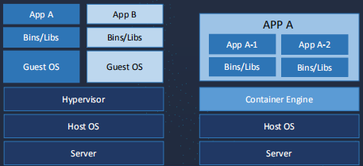
1.2.5 Containers
Container technologies make resource scheduling and microservices easier:
Container is a lightweight virtualization technology that can provide multiple isolated runtime environments on a single server and isolate processes through namespaces. Each container has a unique writable file system and resource quota.
Virtualization vs. Containerization
Notes:
Microservices architecture is naturally suited for containers, a lightweight virtualization technology that can provide multiple isolated operating system environments on a single host.
Container technology is divided into runtime and orchestration layers, runtime is responsible for container computing, storage, networking, etc., and the orchestration layer is responsible for scheduling, service discovery and resource management of container clusters
Container services simplify the construction of container management clusters, integrating scheduling, configuration, storage, networking, etc., to create the best container operating environment in the cloud. Using container technology, users can package microservices and all their required configurations, dependencies and environment variables into container images that can be easily ported to brand new server nodes without reconfiguring the environment, making containers the most ideal tool for deploying individual microservices

Slide 13
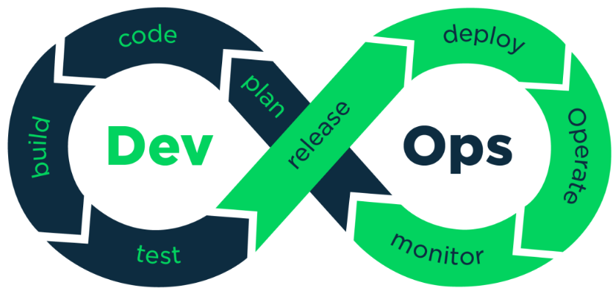
1.2.6 DevOps
DevOps is a collective term for a set of processes, methods, and systems that are used to promote the communication, collaboration, and integration between development (application/software engineering), technical operations, and quality assurance (QA) departments for a start from the end and integrated OPS.
Notes:
What is DevOps?
Development and operations may seem like two seemingly conflicting roles. Because development is responsible for the continuous iteration of the business, it introduces a lot of changes to the system, and if the system is running stably, then each go-live and release brings new risks to the system. And operations is after system availability, and changes mean possible instability.
In the DevOps capability closure loop (shown above), the focus is on
Release product updates earlier and more frequently, always in beta, and respond more quickly to changes.
Rely on automation tools (testing, deployment) to integrate the process of development, testing, release and deployment for instant delivery.
To have this capability, it requires DevOps to involve all people: development, testing, operations and maintenance, to seek common ground while reserving differences, to share responsibility for organizational goals, to work closely together, and to improve product delivery capabilities.

Slide 14
1.2.6 DevOps (continued)
Benefits of DevOps:
Item | Strength
Deployment efficiency | Deployment frequency of code and changes: over 30 times
Lead time | Lead time for code and changes: over 200 times
Deployment success rate | Deployment success rate in production environments: over 60 times
Productivity/Profit target | More than 2 times
......... | ..................
Notes:
The DevOps Research and Assessment (DORA) DevOps study, which surveyed up to 25,000 technical professionals, found that high performers who practice DevOps demonstrate significant advantages over low performers in a number of areas

Slide 15
1.2.6 DevOps (continued)
Process and knowledge system
Notes:
The DevOps process includes "Plan-Require-Design-Develop-Deploy-Operate", which involves knowledge areas such as Agile, Continuous Delivery, Lean, and ITSM.

Slide 16
1.2.6 DevOps (continued)
DevOps tool chain
Notes:
The DevOps tool chain includes version control & collaborative development tools, automated build and test tools, continuous integration & delivery tools, deployment tools, maintenance tools, monitoring, alerting & analysis tools, and more. Different enterprises need to build their own DevOps toolchain according to their development process and team structure.
Tencent Cloud's TAPD product supports mainstream code, build, automated testing, deployment and release tools, helping enterprises to integrate their R&D tool chains and break the platform barriers. It can also visualize and manage process data to help team members quickly grasp pipeline execution, locate failure causes, and quickly respond with feedback on integrated tools as follows.
Code integration tools: Tencent WorkBee, Gitlab, Github.
Code inspection integration tools: SonarQube, Nexus.
Continuous integration and delivery integration tools: Jenkins, Gitlab CI, Ansible.
Automation test integration tools: JUnit, PHP Unit, Python Unit Test.

Slide 17
1.2.7 Continuous delivery
Batched and frequent delivery
Continuous delivery - forward process
Business driven fast feedback loop
Automated OPS collaboration
Continuous deployment
Agile loop
Minimum viable product (MVP)
Monitoring/
Operations
Requirement
Design
Development
Testing
Deployment
Continuous delivery - closed feedback loop
Fast feedback loop
Notes:
The traditional application lifecycle is: requirements-design-development-test-deployment/operations-monitoring/operations, and the application is delivered as a whole.
Continuous delivery is more of an agile way of working, not seeking to be large and comprehensive, but taking the smallest viable product as the delivery unit, receiving feedback and improving it during the delivery process, turning the "application lifecycle: requirements-design-development-test-deployment/operations-monitoring/operations" into a circular and closed loop. Continuous delivery requires building a deployment pipeline that allows every change in the version control system to be committed to the test environment through a standard automated process, and then deployed to production after automated testing.
Continuous delivery enables fast delivery, rapid feedback, and reduced release risk
Build your own CI/CD continuous build pipeline with a release process, such as using Jenkins.

Slide 18
Section 2. Implementation of Serverless Architecture in Tencent Cloud
2.1 Overview of serverless architecture
2.2 Applications and limitations of serverless architecture
2.3 SCF and serverless applications

Slide 19
2.1 Overview of serverless architecture
What is Serverless?
Serverless computing refers to the concept of building and running applications that do not require server management. It describes a finer-grained deployment model where applications, bundled as one or more functions, are uploaded to a platform and then executed, scaled, and billed in response to the exact demand needed at the moment.
- CNCF Serverless Whitepaper
Why use it?
It eliminates the need for high numbers of traditional always online server components
It simplifies development and OPS
It reduces the operating costs and shortens the lead time of business systems
Notes:
How Serverless architecture reduces development, O&M complexity and IT operations costs
Server operations. Serverless dramatically changes the cost model for running software applications by eliminating the overhead involved in maintaining server resources. There is no configuration, updating and management of the server infrastructure.
Elastic Scaling: Serverless FaaS or BaaS offerings can immediately scale precisely to handle each individual incoming request. For developers, serverless platforms have no concept of "pre-planned capacity" and do not require configuration of "auto-scaling" triggers or rules. Scaling is done automatically without developer intervention. After the request is processed, serverless FaaS automatically scales down compute resources to ensure that there is never any free capacity.
Low cost. Serverless computing services do not charge for idle virtual machines or containers; that is, when code is not running or not doing meaningful work. --CNCF, "Serverless Whitepaper

Slide 20
2.1.1 Components of serverless architecture
FaaS
Function as a Service
BaaS
Backend as a Service
API call
COS
Database
Business logic definition
Message queue
Message queue
Code deployment
CDN
…
Code logic
Integrated services
Notes:
FAAS: Functions as a Service is an event-driven, function-hosted computing service. With Function as a Service, developers simply write business function code and set the conditions for it to run, without the need to configure and manage infrastructure such as servers. Function code runs in stateless containers, triggered by events and transient and volatile, and is completely managed by third parties, with the infrastructure completely transparent to application developers. Functions run in a resilient, highly reliable manner and are billed on actual execution resources, with no costs incurred for non-execution. Functions-as-a-Service delivers an unprecedented development experience. Development delivery is more agile, developers only need to write application logic, computing resources are provided in the form of services, no need to consider resource capacity and infrastructure operation and maintenance, further reducing development delivery time; resource utilization is more efficient, function units only run when triggered, and are quickly released after processing, almost no idle time, resource utilization is nearly 100%.
BAAS: The concept of BaaS covers a wide range of third-party services that applications may rely on, such as cloud databases, authentication, object storage, etc. Developers are able to integrate all the required back-end functions through APIs and SDKs provided by BaaS service providers, without having to build back-end applications or manage infrastructure such as virtual machines or containers to ensure that applications uptime. Most of the BaaS services are provided by cloud service providers, and users do not need to care about and maintain the underlying infrastructure resources.
--- "Serverless Architecture Technology White Paper", Cloud Computing Open Source Industry Alliance

Slide 21
2.1.2 Comparison of serverless architecture and mainstream deployment modes
Notes:
Virtual machines, containers and Serverless all abstract IT infrastructure resources, but there are significant differences between the three. Serverless architecture does not completely replace the application of virtual machines and containers, and each has its own advantages and disadvantages in terms of deployment methods, security isolation, ecological integrity, and scenario applicability, and has its own technical audience.
Virtual Machine Deployment: The first choice for steady-state operations. Low latency, predictable high performance, and a better isolated environment make it the deployment of choice for static monolithic applications and performance-sensitive workloads, i.e., high-performance computing applications (e.g., video encoding, machine learning). For large applications, virtual machines are also the primary deployment target, especially for applications that emphasize data persistence and stateful applications.
Container deployment: the best vehicle for microservices architecture, container technology standardizes all applications into manageable, testable, easy-to-migrate images, thus providing a way to integrate the management of different technology stacks
Serverless Deployment: The New Shape of Event-Driven Deployment
--- "Serverless Architecture Technology White Paper", Cloud Computing Open Source Industry Alliance

Slide 22
2.2 Applications and limitations of serverless architecture
Scenarios
Application backend service
Large-Scale data processing and computing
Event-based content processing application
Mobile application backend service
IoT backend service
AI inference and prediction
Batch processing or scheduled task
Real-Time file processing
Custom event trigger
Notes:
Application Backend Services
Mobile application backend services: Building mobile backend services using serverless architecture technology is a very common scenario. It allows developers to build applications on cloud-based backend services. This allows developers to focus more on optimizing their mobile applications by choosing from a rich set of backend services provided by cloud providers on demand. For example, the development of WeChat applets
IOT back-end services: IOT application scenarios, the device transmission data volume is small, and often data transmission at fixed intervals, data transmission has obvious peak and trough characteristics. The peak time of data transmission triggers the centralized processing of back-end function services, which is quickly released after processing to improve the efficiency of resource utilization.
Large-scale data processing and computing classes
AI inference and prediction: The demand for AI inference and prediction calls varies with the ebb and flow of the business and is somewhat volatile. At the same time, AI inference usually uses GPU acceleration, and such significant peak variations can lead to a lot of wasted resources. Using serverless architecture technology can effectively solve these problems. When high business requests arrive, the execution instance of the cloud function automatically scales up to meet business needs; when requests are low or no requests arrive, the cloud function automatically scales down to save resource usage.
Batch or scheduled tasks: With the ability to perform powerful parallel computing in an asynchronous manner for only short runs per day, IO or network access tasks are well suited for serverless architectures. These tasks can consume the required resources while running in an elastic manner and do not incur resource costs for the remainder of the day when they are not being used. Examples include regular data backups, etc.
Event-based content processing applications
Real-time file processing: Some applications will crop images into different sizes or add different label watermarks according to different application requirements. Video applications will transcode video streams into different resolutions and push them to different services. When the image or video stream is uploaded through the object storage, the corresponding function is triggered and processed automatically on demand according to the calculation rules, without the need to build additional servers or manual intervention.
Customized event triggering: Take the scenario of sending emails to verify email addresses when users register as an example, the subsequent registration process can be triggered by customized events without the need to configure additional application serverless to handle the subsequent requests.
---《无服务器架构技术白皮书》，云计算开源产业联盟

Slide 23
2.2.1 Limitations of serverless architecture
Latency concerns
Limitations of serverless
Code debugging
Implementation and control
Vendor lock-in
Notes:
The limitations of function-as-a-service are also obvious at this stage. Code debugging is more complicated, most of the code debugging in FaaS platform needs to be downloaded to local and uploaded to function after successful debugging, the online debugging tool function is not yet perfect, and the complexity of debugging is high.
The code in FaaS is triggered by events, and if the execution is not triggered again after a period of time, the container of the execution function will be destroyed, and there will be start-up overhead and increase the start-up delay, so it is not applicable to low-latency business, such as financial transactions, etc.
As a large number of BaaS services are maintained by vendors, which also makes the serverless architecture of vendor binding phenomenon is more serious
There is a lack of standardization and complete ecosystem, comprehensive and stable documentation, examples, tools and best practices. Going Serverless inherently involves giving up full control of the software stack on which code runs.

Slide 24
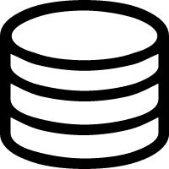
2.3 SCF and serverless applications
SCF
Tencent Cloud Serverless Cloud Function (SCF) is a function-as-a-service (FaaS) product that provides a serverless FaaS computing platform. It can be triggered by events.
SCF function definition
Image
upload
SCF
Outputs different formats: phone, tablet, PCs
COS
COS
Sample SCF function
Notes:
Serverless Cloud Function (SCF) is a serverless execution environment provided by Tencent Cloud for enterprises and developers to help users run code without the need to purchase and manage servers. Users simply write core code in a platform-supported language and set the conditions for running the code, and then run the code elastically and securely on Tencent Cloud infrastructure. SCF is the ideal computing platform for scenarios such as real-time file processing and data processing. When using cloud functions, users only need to focus on their own code.
Tencent Cloud fully manages the underlying computing resources, including server CPU, memory, network and other configuration/resource maintenance, code deployment, elastic scaling, load balancing, security upgrades, resource operation monitoring, etc. Users only need to provide code in the language supported by the platform. The code will be scaled up and down according to the request load during execution, without manual configuration and intervention to meet the availability and stability of the service under different scenarios, from a few requests per day to thousands of requests per second, all scaled by the underlying cloud function itself. Cloud Functions are automatically deployed across multiple availability zones within a geography, providing extreme fault tolerance. Users only pay for running cloud functions, and no costs are incurred when the code is not running.

Slide 25
2.3.1 How SCF works
SDK
Web
COS
CMQ
…
Invocation source
API
Access layer
Function configuration
Function invocation
Control layer
Function scheduling
Resource call
…
Resource creation or repossession
Function instance
Function instance
Function instance
Execution layer
Notes:
Call source: function call from the user or internal cloud product event trigger, currently supports: manual trigger (API), timing trigger, COS trigger, CMQ trigger, API gateway trigger and other triggering methods
Access layer: load user authentication and other issues
Control layer: distribution of load function calls, function configuration, function instance life cycle management, dynamic expansion and contraction, disaster recovery scheduling, load balancing, etc.
Function call: Use existing instances directly, and create new instances by scheduling if there are not enough instances
Function scheduling: expansion and contraction of instances and code changes
Execution layer: load runtime environment, execution of user functions

Slide 26
2.3.1 Main parameters of SCF
Function memory (MB) | 128–1,536 in increments of 128 MB
CPU | Proportional to memory
OS | CentOS 7
Deployment mode | Zip package upload or COS file reference
Support languages | Python, Node.js, PHP, Java, and Go
Triggers | API Gateway, COS, CMQ, CKafka, and timers
Maximum function execution duration | 300s
Log monitoring tools | CLS and CM
Billable items | Function execution duration and allocated memory size
Maximum concurrency | 100 per function

Slide 27
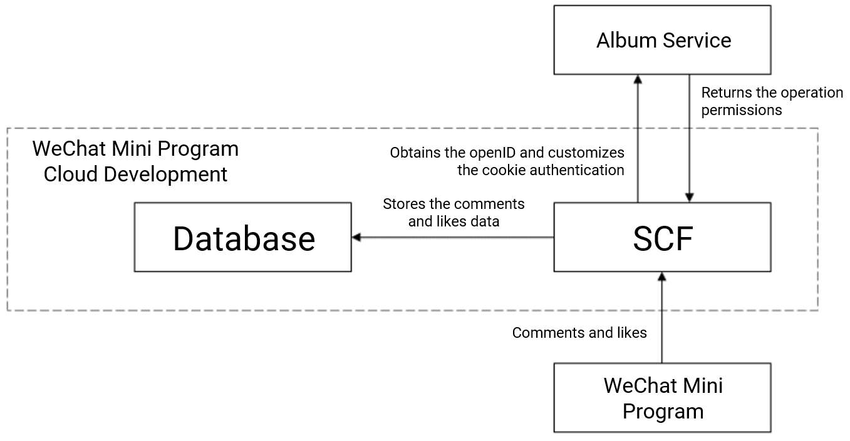
2.3.3 Use cases of SCF
Tencent Photo Manager used SCF to optimize its WeChat Mini Program development
Notes:
Background: Tencent Photo Album is connected with space albums through the applet, realizing the functions of uploading, downloading, sharing with friends, liking, commenting and generating applet codes at the applet end.
Pain points.
Small program is a new project, manpower is very tight, the background can not be 100% invested
Backend system has historical baggage and new features are difficult to develop
Building an applet architecture using the traditional development model is time-consuming and labor-intensive. In addition to data reading, file management, handling of sensitive logic (such as permissions), there are many technical issues to consider such as elastic scaling, disaster recovery, load balancing, etc.
Serverless Cloud Function Solution: Applet - Cloud Development is a native Serverless cloud service jointly developed by the WeChat team and Tencent Cloud and integrated into the applet console. The core functions include: cloud functions, cloud database and cloud storage. Users only need to write core logic code, no need to pay attention to back-end configuration and operation and maintenance, focus on business development .
Taking the fast-launching like comment function as an example, the following typical problems exist.
The addition of user authentication information required for operations such as applet comments and likes.
The original back-end service architecture was too complex and it was very difficult to add new features
After building the service via Serverless architecture, we use the cloud function routing function to obtain the user's authentication information in the original album service, match the original backend service, and determine whether the user has the authority to perform sensitive operations in the applet side to easily realize the business requirements. The functions are as follows
The operation of pulling and storing data such as comments and likes on the applet side.
When operations such as commenting and liking are performed at the applet side, the user's authentication information is obtained at the original album service side through the routing function of the cloud function.
--- "Serverless Architecture Technology White Paper", Cloud Computing Open Source Industry Alliance

Slide 28
Reflection questions
Q1: what are the key technologies of cloud native?
Q2: what are the use cases of serverless architecture?
Notes:
Question 1: Microservices, containers, CI/CD, DevOps
Question 2: Domain-driven design, AKF extension model
Issue 3: Application back-end services, large-scale data processing and computing applications, event-based content processing applications

Slide 29
Course summary
This course covered:
Key technologies of cloud native application
Serverless architecture

Slide 30
Thank you!
Notes:
This marks the end of the second chapter in the Tencent Cloud Solutions Architect Associate course. See you in the next chapter!

